Slide 1

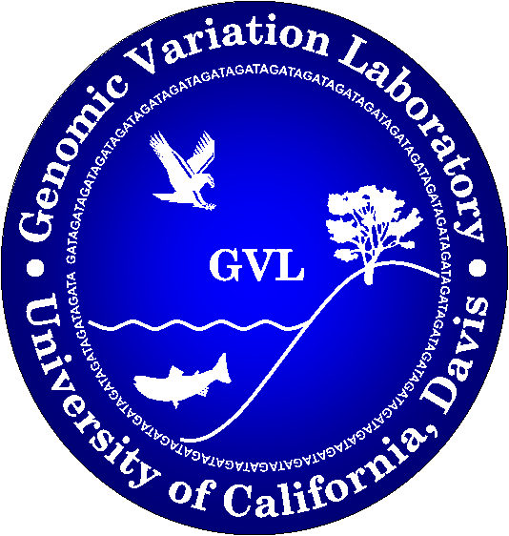
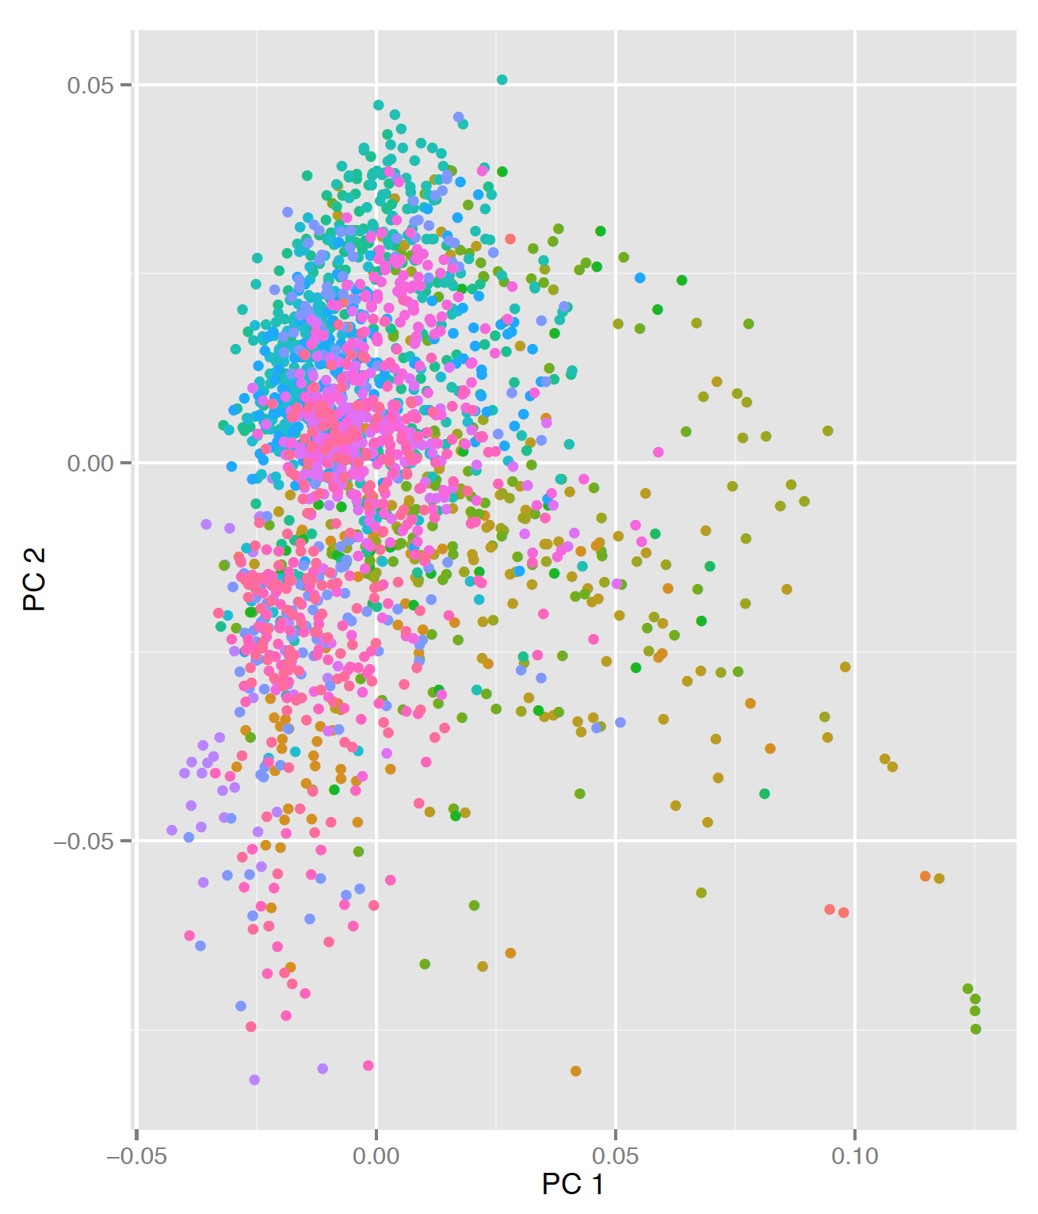
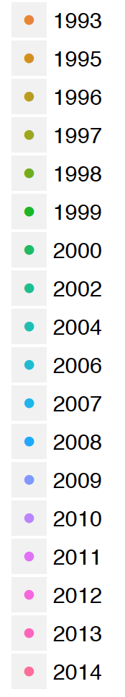




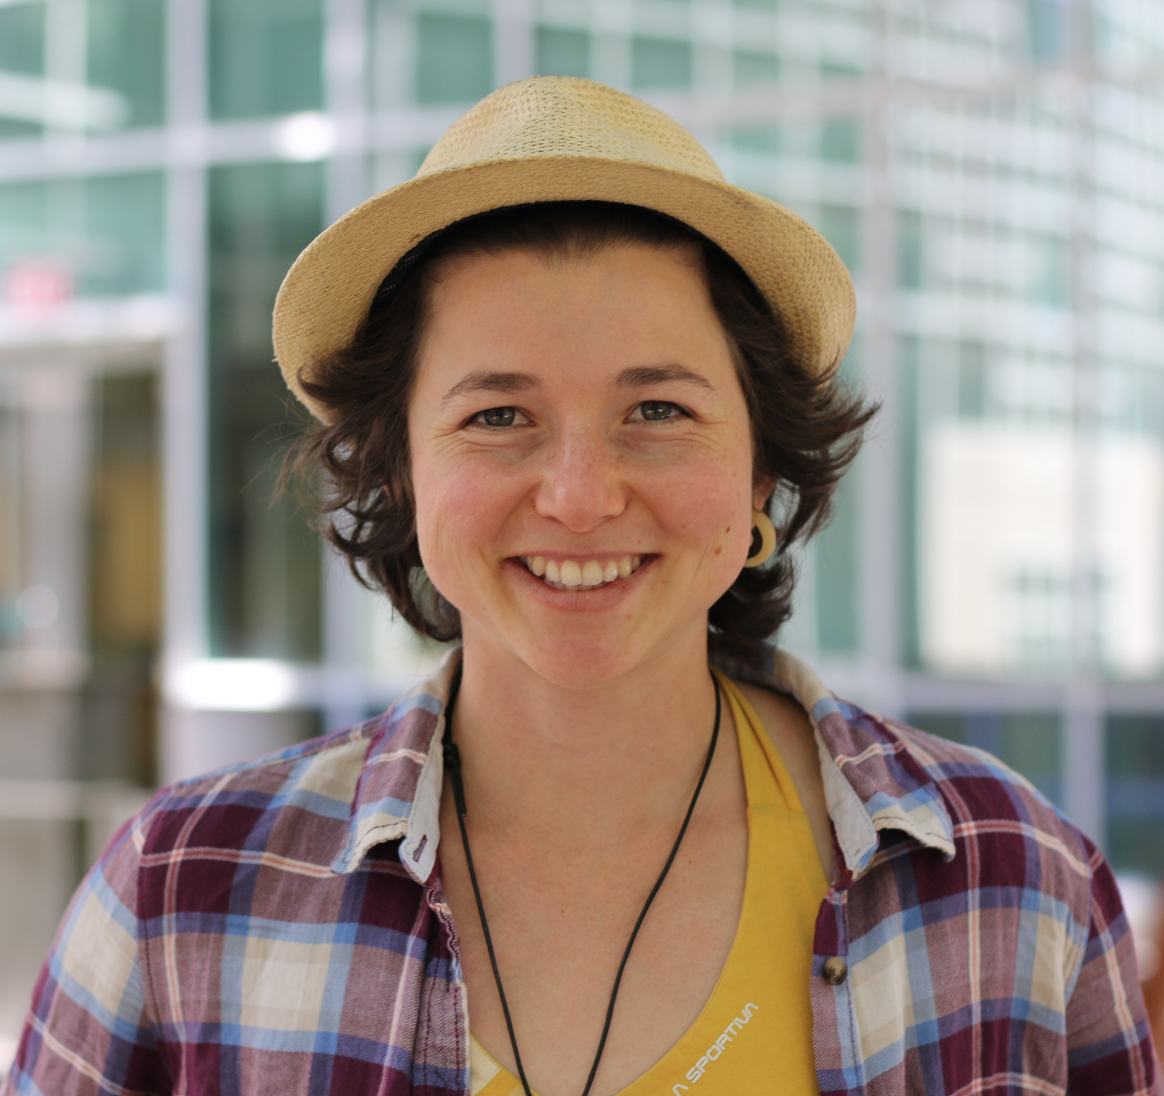


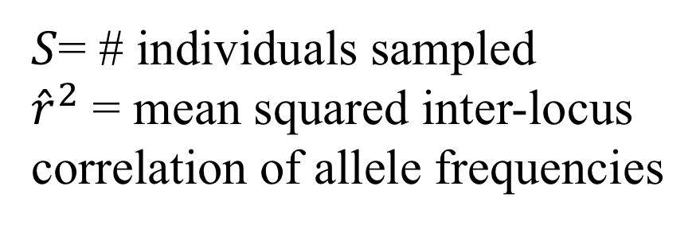
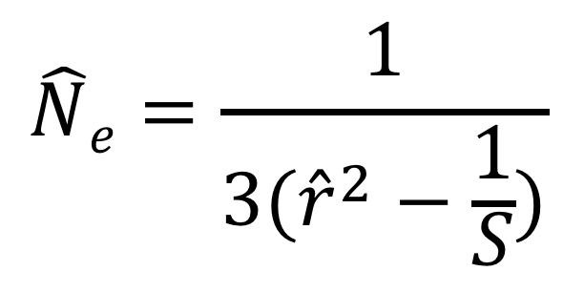
Estimating effective population size (Ne) of wild Delta Smelt using RAD-seq
Shannon E.K. Joslin^{1,3} and Amanda J. Finger^{2,3}
¹Integrative Genetics and Genomics Graduate Group, ²Department of Animal Science and ³Genomic Variation Laboratory; University of California, Davis
Purpose
Research Questions:
PCA plot of wild Delta Smelt
The effective population size (Ne) of a population provides insights into demography history and extinction risk of species of interest and is an important parameter in conservation biology
The purpose of this study is to develop techniques to sensitively estimate Ne in Delta Smelt using RAD-seq data
Develop a bioinformatics pipeline to be used to monitor the genetic diversity of non-model organisms
Determine if declining abundances of Delta Smelt has affected the species’ genetic diversity
Are lower abundances of Delta Smelt negatively affecting the species genetic diversity?
What is the most sensitive and accurate way to estimate the effective population size of Delta Smelt?
Birth Year
Sequencing Methods
Microsatellite (previous work) – samples 12-15 sites throughout the genome
marker
linkage group
PC 2 (0.22%)
RAD-seq (current work) – samples thousands of loci genome-wide
Linkage
Group 1
Linkage
Group 2
Background
Species
Hypomesus transpacificus (Delta Smelt) is a small translucent estuarine fish endemic to the San Francisco Estuary
Delta Smelt population abundances have been declining since the 1970s and have been protected under the federal and California Endangered Species Act since 1993
Currently, Delta Smelt abundances are monitored though regular surveys¹
Despite an intense amount of research into the species the population abundances continue to decline
Techniques
Previous studies have used temporal (Ne_{T}) and linkage disequilibrium Ne_{LD} methods to estimate Ne of the wild Delta Smelt population using 12-15 microsatellite markers²⁻³
Estimation of Ne
Temporal
Multiple Generations
PC 1 (0.36%)
B allele
b allele
Compare allele frequencies genome wide to measure degree of genetic drift.
Gen 1
f(B)_{G1=}0.66
Terms Defined
Gen 2
f(B)_{G2=}0.50
Ne: The effective population size of an ideal population. This term measures the amount of genetic diversity maintained within a population.
Ne_{LD}: A temporal method of estimating effective population size. This method uses samples from different generations.
Ne_{T}: A linkage disequilibrium method of estimating effective population size. This method uses samples individuals from a single generation.
Linkage Disequilibrium: The nonrandom association of alleles at different loci in a given population.
RAD-seq: Restriction site Associated DNA Sequencing
Linkage Disequilibrium
Single Generation
$$\hat{N}e=\frac{1}{3({\hat{r}}^{2}−\frac{1}{S})}$$
How often is associated with ?
$S$= # individuals sampled
${\hat{r}}^{2}$ = mean squared inter-locus correlation of allele frequencies
Contact
Shannon E.K. Joslin
Email: sejoslin@ucdavis.edu
References [1.] Baxter, R. et al. An updated conceptual model of Delta Smelt biology: our evolving understanding of an estuarine fish. 224 (2015). [2.] Nunziata, S. O. & Weisrock, D. W. Estimation of contemporary effective population size and population declines using RAD sequence data. Heredity (Edinb). 1–12 (2017). doi:10.1038/s41437-017-0037-y [3.] Fisch, K. M., Henderson, J. M., Burton, R. S. & May, B. Population genetics and conservation implications for the endangered delta smelt in the San Francisco Bay-Delta. Conserv. Genet. 12, 1421–1434 (2011). [4.] Finger, A. J., Schumer, G., Benjamin, A. & Blankenship, S. Evaluation and Interpretation of Genetic Effective Population Size of Delta Smelt from 2011–2014. San Fr. Estuary Watershed Sci. 15, (2017). [5.] Lew, R. M. et al. Using Next-Generation Sequencing to Assist a Conservation Hatchery: a Single-Nucleotide Polymorphism Panel for the Genetic Management of Endangered Delta Smelt. Trans. Am. Fish. Soc. 144, 767–779 (2015).
Acknowledgments
The authors thank Alisha M. Goodbla and Alyssa Benjamin for the extraction of DNA and sequencing of Delta Smelt samples. This research was supported under the California Department of Water Resources (46000110669) at UC Davis. The library prep was carried out at the Genomic Variation Laboratory and sequencing at the UC Davis Sequencing Center.
@IntrprtngGnmcs
http://github.com/shannonekj
okay to photograph

